Slide 1
Application of Electrochemistry Chemistry
Chapter 10

Slide 2
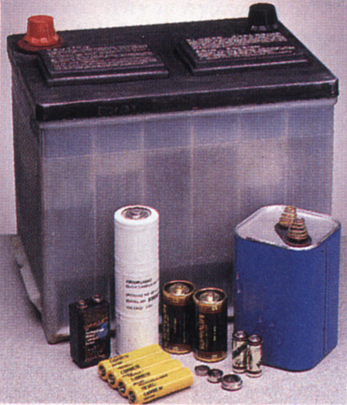
Electrochemistry

Slide 3
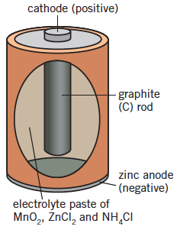
Dry Cell
Primary cell – spontaneous redox reaction only occurs once
Zinc anode, graphite rod cathode, surrounded by powdered manganese dioxide MnO₂
Electrolyte is moist paste of NH₄Cl and ZnCl₂
Called a dry cell as uses paste instead of liquid

Slide 4
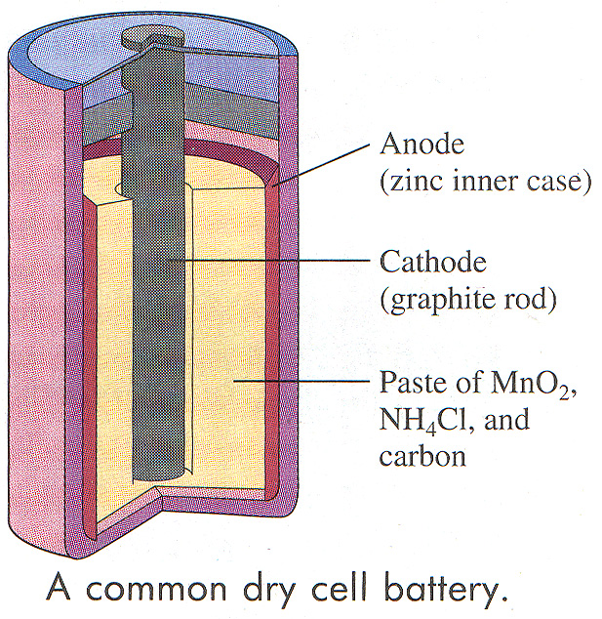
The Common Dry Cell Battery
Anode: Zn ⎯→ Zn²⁺ _{(aq)} + 2e-
Cathode:
2NH₄⁺ + 2MnO₂ + 2e- ⎯→ Mn₂O₃ + NH₃ + H₂O

Slide 5
Dry Cell redox reaction
Anode:
Zn_{(s)} → Zn²⁺_{(aq)} + 2e⁻
Cathode:
2MnO_{2(s)} +2NH₄⁺_{(aq)}+ 2e⁻ → Mn₂O_{3(s)} + 2NH_{3(aq)} + H₂O_{(l)}
Anode: The electrode where oxidation is occurring
Cathode: The electrode where reduction is occurring
Cell does not last as ammonium chloride formed during reaction provides acidic environment that corrodes the zinc anode

Slide 6
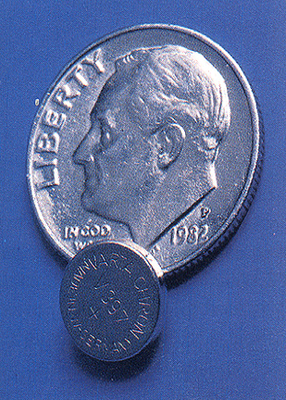
Silver Oxide Cell
Primary cell – with a long life.
Major disadvantage is cost and
environmental hazards
Anode: Zn_{(s)} → Zn²⁺_{(aq)} + 2e⁻
Cathode: Ag₂O_{(s)} +H₂O_{(l)} +2e⁻ → 2Ag_{(s)} + 2OH⁻_{(aq)}
Button cells found in calculators and watches.

Slide 7
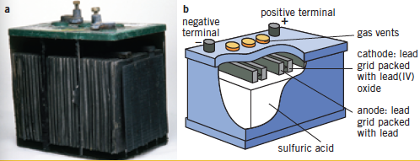
Lead-acid accumulator
Used as car battery

Slide 8
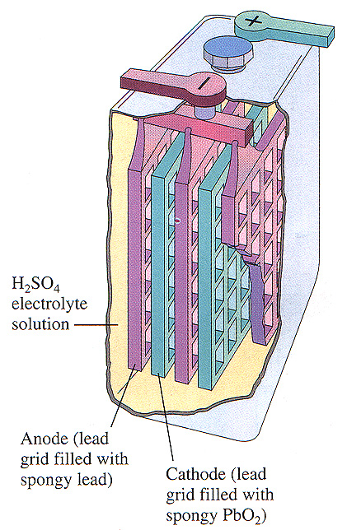
Lead Acid Battery (Car Battery):
Anode:
Pb _{(s)} ⎯→ Pb ²⁺_{(aq)} + 2e-
Cathode:
PbO_{2(s)} + 2e- + 4H⁺_{(aq)} ⎯→ Pb ²⁺_{(aq)} + 2H₂O_{(l)}
The overall equation is
PbO_{2 (s)} + Pb _{(s)} + 2H₂SO_{4(aq)} ⎯→ Pb SO_{4(aq)} + 2H₂O _{(l)}

Slide 9
Lead Storage Batteries
Lead storage batteries are used in all automobiles
It uses lead metal, Pb as the reducing agent and lead (IV) oxide, PbO₂ as the oxidizing agent
Sulfuric acid, H₂SO₄ provides the H⁺ needed for the reaction. It also provides SO₄²⁻ ions that react with the Pb²⁺ ions to form PbSO₄ _{(s)}
The PbSO₄ _{(s)} coats the lead electrodes and will cause the battery to go flat.

Slide 10
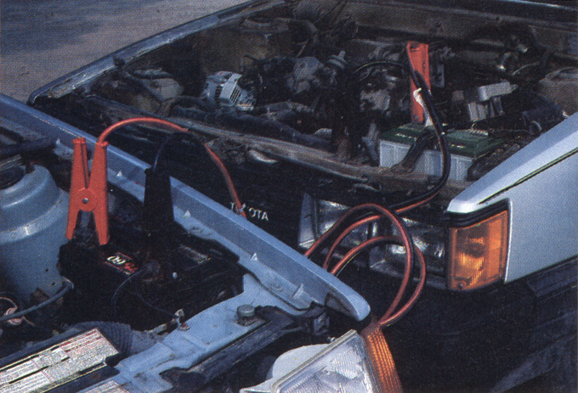
Reverse the redox reaction to recharge the car battery.
Your car uses an alternator which generates electricity which is used to recharge the battery, by passing an electric current back into the battery. This turns the Pb ²⁺ back into PbO_{2 (s)} + Pb
PbSO_{4(s)} + 2H₂O _{(l)} ⎯→ PbO_{2 (s)} + Pb _{(s)} + 2H₂SO_{4(aq)}

Slide 11
Summary: During discharging Process
Anode: Pb_{(s)} + SO₄²⁻_{(aq)} → PbSO_{4(s)} + 2e⁻
Cathode:
PbO_{2(s)}+ SO₄²⁻_{(aq)}+ 4H⁺_{(aq)}+ 2e⁻ → PbSO_{4(s)} + 2H₂O_{(l)}
Overall reaction
Pb_{(s)}+ PbO_{2(s)}+ 4H⁺_{(aq)}+ 2SO₄²⁻_{(aq)}→ 2PbSO_{4(s)}+2H₂O_{(l)}
2PbSO_{4(s)} formed at both electrodes, sulfuric acid consumed in reaction

Slide 12
Summary: During recharge process
Most batteries composed of 6 cells each giving a cell potential of 2V – creating total of 12V
Can be recharged, external voltage greater than cell potential is applied, the electrode reactions can be reversed and PbSO₄ being reduced to Pb at one electrode and oxidised to PbO₂ at the other
Recharging reaction
2PbSO_{4(s)} + 2H₂O_{(l)} → Pb_{(s)} + PbO_{2(s)} + 4H⁺_{(aq)} + 2SO4²⁻_{(aq)}

Slide 13
Nickel-cadmium cell
Light weight, portable, rechargeable cell
Anode cadmium metal surrounded by potassium hydroxide paste
Reaction:
Cd_{(s)} + 2OH⁻_{(aq)} → Cd(OH)_{2(s)} + 2e⁻
Cathode nickel oxyhydroxide
Reaction:
2NiO(OH)_{(s)} +2H₂O_{(l)} + 2e⁻ → 2Ni(OH)_{2(s)} + 2OH⁻_{(aq)}

Slide 14
Lithium Ion Cell
Used in mobile phones and laptop computers.
Lithium is a very reactive metal with the standard reduction potential (E°) for the reaction Li⁺ + e⁻ → Li_{(s)} being around –3 V.
Anode is made of carbon (graphite) into which the lithium ions are inserted
In the presence of the delocalised electrons in the graphite, the lithium ion can be made to behave like a lithium atom
A strong reductant. The reductant is assigned the formula Li_{x}C₆ or more simply Li(C).

Slide 15
Lithium ion cell
Cathode is formed when Lithium ions are incorporated into the layers of cobalt oxides and produce a reversible electrochemical process in which the cobalt ion in the complex oxide changes back and forth between Co⁴⁺ and Co³⁺.
Lithium acts as reactive element therefore no water can be found in electrolyte.
Anode: Li_{x}C₆ → xLi⁺ + 6C + xe-
Cathode: Li_{1–x}CoO₂ + xLi⁺ + xe- → LiCoO₂

Slide 16
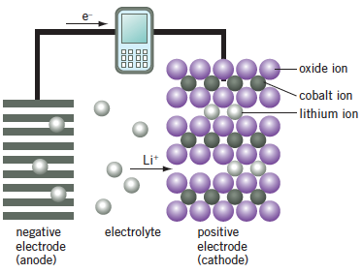
Lithium ions migrate from anode to cathode through the electrolyte

Slide 17
Fuel cells
Created where reactants are supplied and products removed continuously.
Example hydrogen and oxygen creating water
Electrodes are porous carbon (and catalyst)
Electroyte HCl or KOH
Very expensive
Are used in some spacecraft.

Slide 18
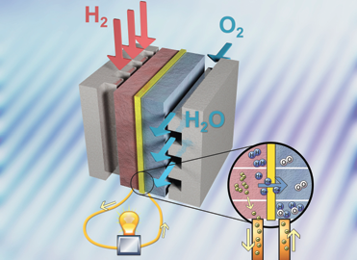

Slide 19
Fuel cell reactions
With an acid electrolyte
Anode: H_{2(g)} → 2H⁺_{(aq)} + 2e⁻
Cathode: O_{2(g)} + 4H⁺_{(aq)} + 4e⁻ → 2H₂O_{(l)}
With an alkaline electrolyte
Anode: H_{2(g)} + 2OH⁻ _{(aq)} → 2H₂O(l) + 2e⁻
Cathode: O_{2(g)} + 2H₂O_{(l)} + 4e⁻ → 4OH⁻ _{(aq)}
The overall reaction, for both electrolytes, is:
2H_{2(g)} + O_{2(g)} → 2H₂O_{(l)}

Slide 20
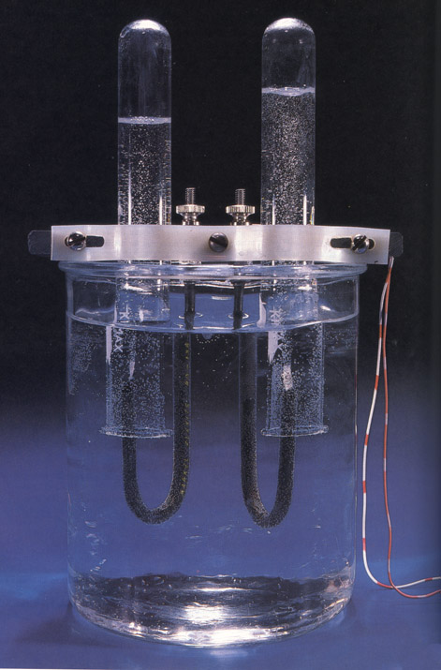
O_{2 (g)}
H₂ _{(g)}
Electrolysis of water:
H₂O_{(l)} ⎯→ O_{2 (g)} + H₂ _{(g)}

Slide 21
Dye-sensitised solar cells
At anode: sunlight excites electrons in dye, electrons move around circuit in cell
At cathode: triiodide(I3-) are reduced to iodide(I-). Iodide ions migrate to dye and regenerate it.
Electrodes are made from glass with a platinum layer transparent to light (acts as conductor)

Slide 22
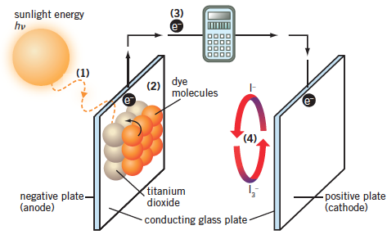
Dry sensitised solar cells

Slide 23
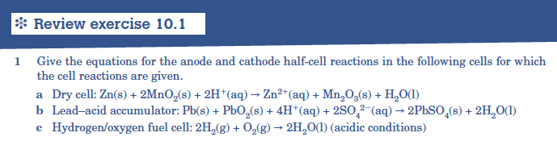

Slide 24
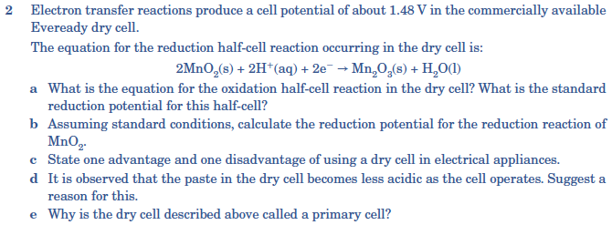

Slide 25
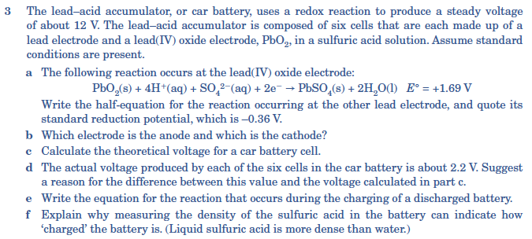

Slide 26
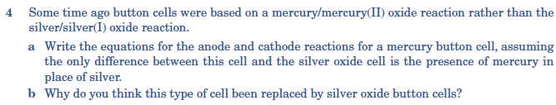

Slide 27

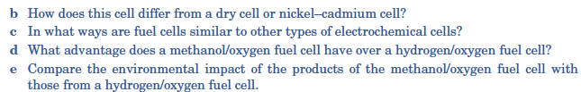

Slide 29
Corrosions of metals
All metals except a few react with oxygen
Aluminium reacts with oxygen to produce aluminium oxide which then prevents further corrosion
Iron and copper less reactive than aluminium but will react especially when heated.
Unlike aluminium the oxide coating of these metals is flaky and exposes fresh metal underneath to the air and water leading to more oxidation.

Slide 30
Rusting of Iron
Iron acts as anode where oxidation occurs changing Fe to Fe²⁺
Anode: Fe_{(s)} → Fe²⁺_{(aq)} + 2e⁻
The cathode may be an impurity, such as carbon, in the iron, or a region of high oxygen concentration – reduction occurs
Cathode: O_{2(g)} + 2H₂O_{(l)} + 4e⁻ → 4OH⁻ _{(aq)}

Slide 31
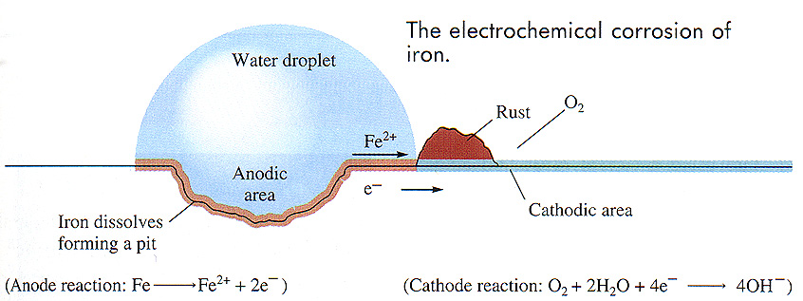

Slide 32
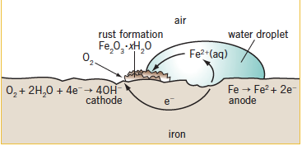

Slide 33
Rusting
Rate of rusting can increase in the presence of other electrolytes for example beside the sea or pollutants such as NO₂ or SO₂.
These allow iron (II) ions to diffuse towards hyroxide ions easier
Fe²⁺_{(aq)} + 2OH⁻_{(aq)} → Fe(OH)_{2(s)}
These are further oxidised to Iron (III) hydroxide
Fe(OH)_{2(s)} + OH⁻_{(aq)} → Fe(OH)_{3(s)} + e⁻
This is then dehydrated to Iron oxide Fe₂O₃·xH₂O

Slide 34
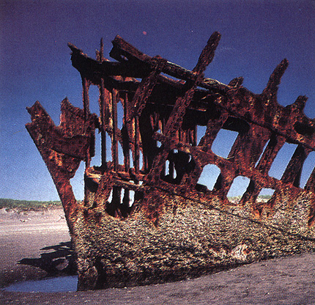
Rusting
Overall equation:
4Fe_{(s)} + 3O_{2(g)} + 2_{x}H₂O_{(l)} ⎯→ 2Fe₂O_{3.}xH₂O_{(s)}

Slide 35
How do you prevent corrosion?
You need to prevent water and oxygen from coming into contact with metals that will oxidize by:
Coating metals in oil, paint, plastic or another metal
Cathodic protection
Or create alloys of iron that resist corrosion like stainless steel

Slide 36
Application of surface coating
Prevents oxygen and water from coming in contact with iron – coating with either metal or non-metal
If less reactive metal is used then any scratch will cause greater oxidation of iron as it will act as the anode

Slide 37
Galvanising
Coating with more reactive metal example zinc which will oxide before iron

Slide 38
Cathodic Protection
Connecting iron to piece of more reactive metal by conducting wire. More reactive metal is sacrificially oxidised (sacrificed metal can be replaced easily)

Slide 39
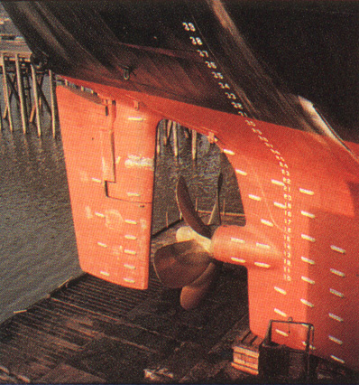

Cathodic protection of metal
This is a way of protecting steel on ships, buried fuel tanks and pipelines
A metal that is a better reducing agent than steel is attached to the steel

Slide 40
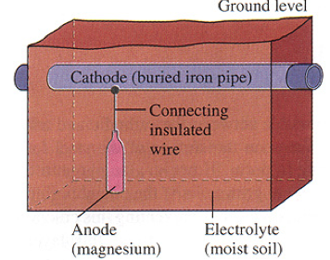
Cathodic protection of metal
The magnesium is a stronger reducing agent than iron.
So electrons flow from the magnesium into the iron, rather than from out of the iron.
This stops the iron from being oxidized.
As oxidation of the magnesium occurs, the magnesium dissolves and needs to be replaced periodically.

Slide 41
Cathodic Protection
Making the iron the cathode of electrolytic cell.
Cell made up of direct current power source, anode is scrap metal and iron is cathode
Current makes iron negatively charged and prevents oxidation.
Scrap metal must be replaced

Slide 42
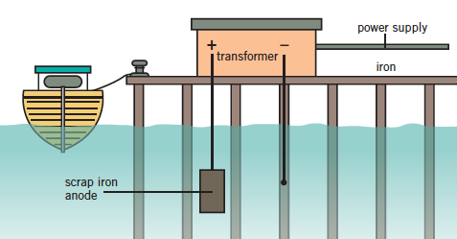
Cathodic Protection

Slide 43
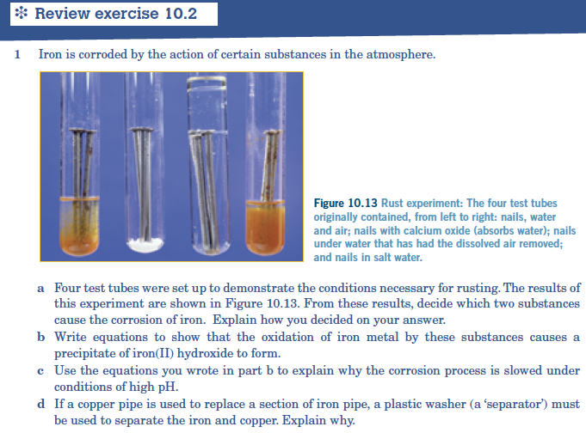

Slide 44
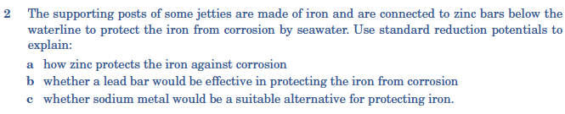

Slide 45
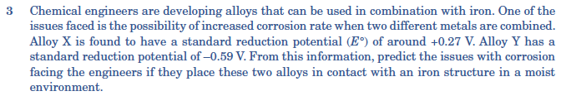

Slide 46
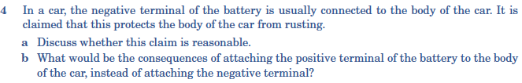

Slide 47


